Slide 1
Module Monitor and Alarm
Presenter: Do Chi Thanh

Slide 2
Overview

Slide 3
Fog

Slide 4
Cloud

Slide 5
Detail
Monitor
  Request past data from Influx database
  Receive message from Collector
  Send message received to Fluentd
  Compare data received and past data and alarm if anomaly occur
  Send alarm request to Alarm module

Slide 6
Detail
Alarm
  Receive request from Monitor module
  Forward/Process alarm message to Fluentd

Slide 7
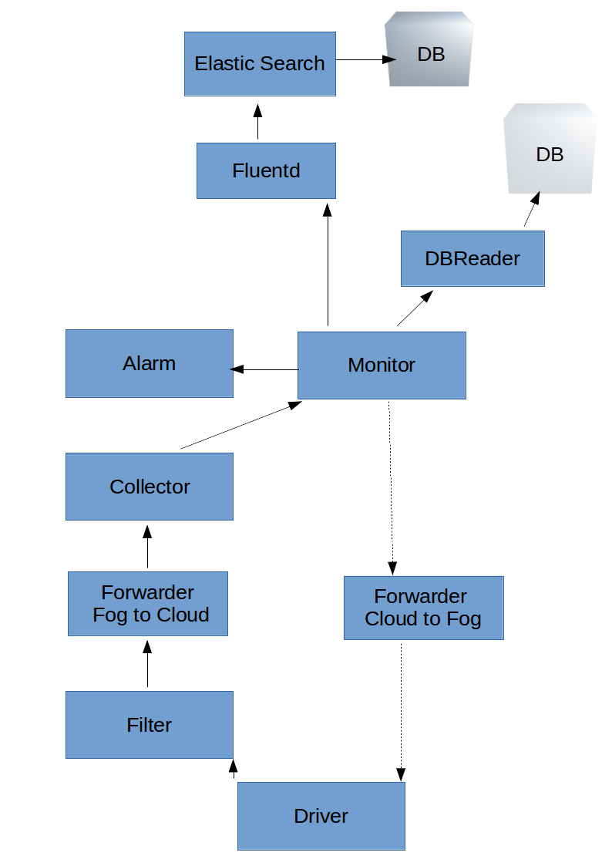

Slide 8
Fluentd
Transform data from input sources (rabbitmq) to output sources (Elastic search)

Slide 9
Thanks for listening

Slide 11
Rule API
Rule DB
Rule Engine
Alert
Alert DB
Monitor
Collector
API set state
Forwarder
Fog to Cloud
Forwarder
Cloud to Fog
Filter
Driver

